Slide 1
Debugging in Android Studio
CTAPDEVL
Prepared by:
Elizer Ponio Jr.

Slide 2
Contents
The Logcat window
Log levels
Logging and Filtering

Slide 3
Logcat

Slide 4

Logcat window
The Logcat window in Android Studio helps you debug your app by displaying logs from your device in real time

Slide 5
Logcat window
Logcat shows a message followed by the associated stack trace containing links to the line of code.

Slide 6
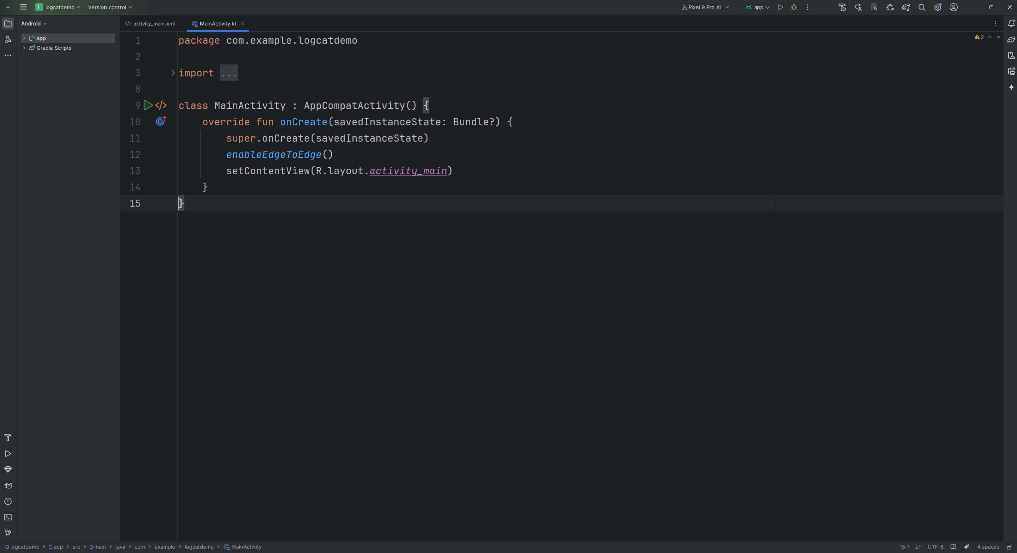

Logcat window
Logcat can be accessed by clicking this icon in Android Studio

Slide 7
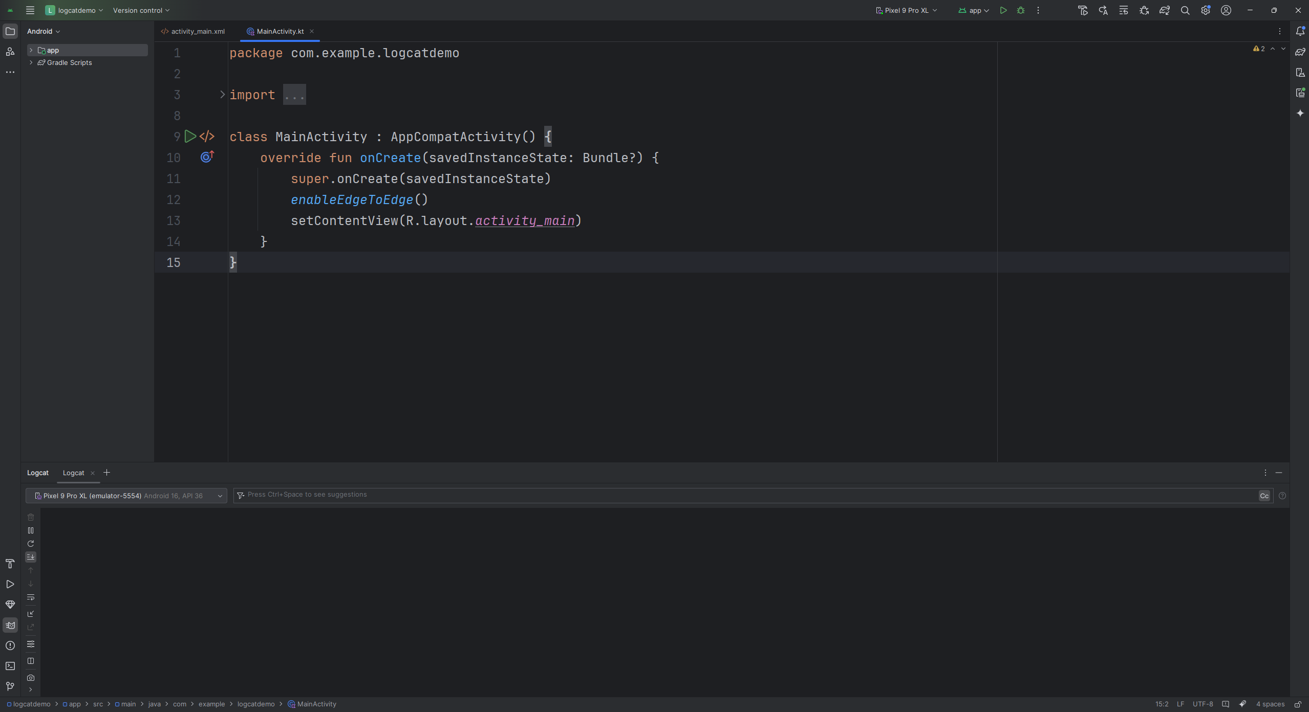
Logcat window
You must first select the device or emulator that Logcat will listen to.

Slide 8
Log levels

Slide 9
Log Levels
Log messages are categorized into different log levels to indicate their severity and importance.

Slide 10
Log Levels
These levels help developers filter logs based on relevance.

Slide 11
Log Levels
The main log levels in Logcat are:
V
VERBOSE
E
ERROR
D
DEBUG
A
ASSERT
I
INFO
W
WARN

Slide 12
When to use a log level?
V
VERBOSE
The lowest priority log level.
Used for detailed debugging messages that contain a lot of information but may not be necessary for every log check.

Slide 13
When to use a log level?
D
DEBUG
Debugging messages intended for development use.
These logs provide useful insights for troubleshooting but should not be enabled in production builds.

Slide 14
When to use a log level?
I
INFO
General information messages that highlight the progress of the application but are not necessarily problems.

Slide 15
When to use a log level?
W
WARN
Indicates potential problems or issues that may not cause immediate failures but should be looked into.

Slide 16
When to use a log level?
E
ERROR
Used for serious issues that indicate an error in the application, which might cause malfunctioning or unexpected behavior.

Slide 17
When to use a log level?
A
ASSERT
The highest priority level,
Used for critical failures that should never happen.
This level is rarely used and is often associated with Log.wtf()(What a Terrible Failure).

Slide 18
Logging and Filtering

Slide 19
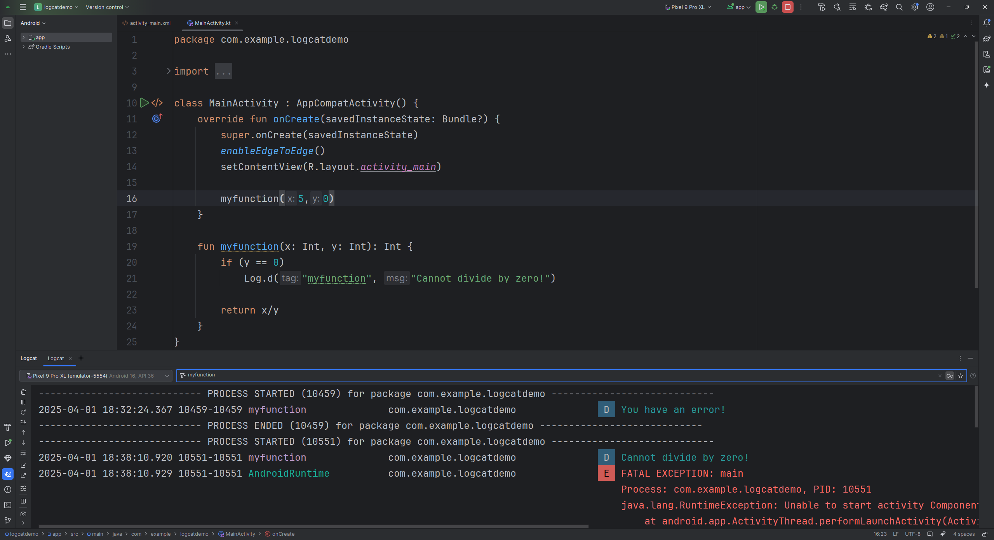
The Log Class
The Log class is used to create logs.
In this example Log.d()is used to indicate that the log level is
D
DEBUG

Slide 20
The Log Class
The Log class accepts two parameters, the tag and the log message.

Slide 21
Filtering log messages
The tag parameter can make finding log messages faster when filtering in logcat

Slide 22
Filtering log messages
Logcat has a filter section where you can directly search using the tag name or the log level of a certain log message

Slide 23
END

